Slide 1
Planetarium Full-Stack Project Presentation
By Jizhong Lin
May.8 2024

Slide 2
Overview
The Planetarium is a web service that allows Astronomers (Users) to record planets and associated moons to a central database as they map the night sky.
Users must register an account to participate, and those who do will be able to associate themselves with the planets and moons they add to the database.
Users can observe all the planets and moons added to Planetarium with or without a search condition from the webpage, and also perform celestial deletion as requested

Slide 3
Technology
Project is written in Java, applied javalin for web service handling and repository fetching
SQLite database manages the user data, Dbeaver provides database GUI to developers
SLF4J package is used to web service logging and stacks error or exception trace
Jira alone with AIO test plugin facilitates the software management on cloud, which keep track of the test cases and defects
System testing is introduced to ensure the overall functionality of web service is solid and clear to end users

Slide 4
Business Requirements
Users should be able to open a new account with the Planetarium
Users should be able to securely log in to their account
Users should be able to add new Planets to the Planetarium
Users should be able to remove Planets from the Planetarium they previously added
Users should be able to add Moons to the Planetarium associated with their Planets
Users should be able to remove Moons from the Planetarium they previously added
Users should be able to view Planet and Moons they have added to the Planetarium

Slide 5
Software Requirements
Users should have unique usernames
Usernames and passwords should not be longer than 30 characters
Users should only see Planet and Moon data for resources they have added to the Planetarium
Planet and Moon names should not have more than 30 characters
Planets and moons should have unique names
Planets should be “owned” by the user that added it to the Planetarium
Moons should be “owned” by the Planet the User adding the moon associated it with

Slide 6
Testing Requirements
System Test
All Software and Business requirements require a minimum of one positive test and one negative test
All Software and Business requirements that limit data input require Boundary Analysis Testing
All Software and Business requirements that limit data visibility or interaction require Exploratory Testing
User Acceptance Test
Is the intended use of the service intuitive
Is the service easy to use
Does the service inspire confidence
Is the service pleasing to look at

Slide 7
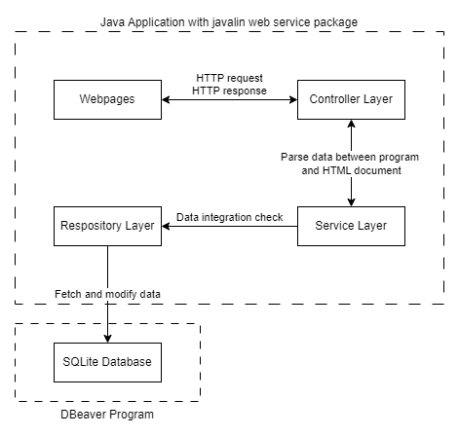
Development
Planetatrium.db file records all the planets and moons data added by users, the database connection is controlled by jdbc sqlite driver manager
Entry point of project is in src/main/java/com/revature/MainDriver.java file
HTTP requests handling is in src/main/java/com/revature/utilities/RequestMapper.java
Data Access Object like user, planet, moon is provided in package com/revature/models
Frond-end webpages for user interaction is in foler src/main/resources/pages
HTTP request and response information is parsed on controller layer
Data integration check and input/output verification is done in service layer
Data selection and manipulation between program and database is performed in repository layer

Slide 8
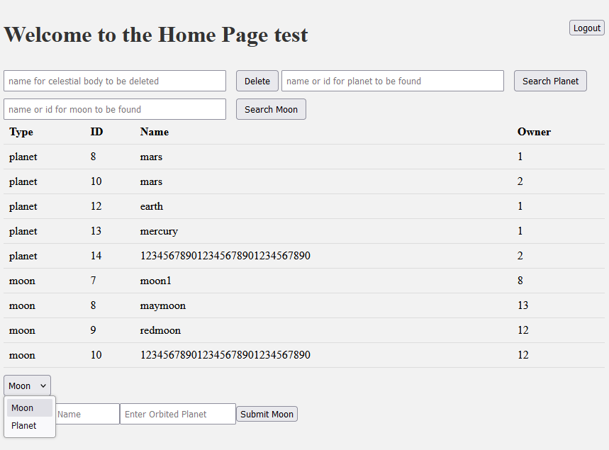
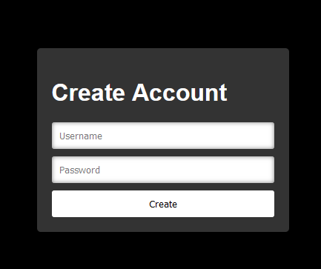
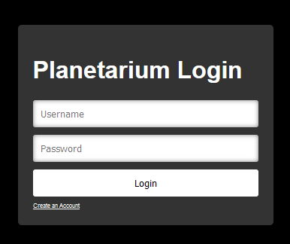
Web Pages

Slide 9
Testing
It is based on business requirement and software requirements
It applies Boundary Analysis Testing and Exploratory Testing techniques
Test cases and defect report is available on Jira
All the testing documents are included in the GitHub repository
Testing is conducted in sequence of user authentication, and data CRUD operations
System testing is performed on the top of application where end users interact on the webpages
User acceptance testing is consumed to ensure the great user experience is presented

Slide 10
References
https://github.com/Alex-Lin5/PlanetsAndMoons
https://jizlin575.atlassian.net/jira/software/c/projects/PAM/boards/5

Slide 11
Thank you for listening! Question?
By Jizhong Lin
May.8 2024

